Slide 1
Digital portfolio
STUDENT NAME: ABINAYASRI A
REGISTER NO AND NMID: asunm1689222409706
Department: Computer SCIENCE
College: UNIVERSITY OF MADRAS

Slide 2
PROJECT TITLE
COLORFUL Profile CARD PROJECT

Slide 3
AGEND
Project overview
End users
Tools and technologies
Portfolio design and layout
Problem statement
Features and functionality
Results and screenshots
conclusion

Slide 4
PROBLEM STATEMENT
To create an attractive and responsive profile card that demonstrates the use of HTML for structure, CSS for design, and JavaScript for interactivity.

Slide 5
PROJECT OVERVIEW
This project is a simple web-based profile card. It contains user details such as name, role, and bio with styled UI. A theme toggle and follow button are included for interaction.

Slide 6
END USERS
Students learning web development
Beginners practicing HTML, CSS, and JS
Anyone who wants to build a portfolio or profile card design

Slide 7
TOOLS AND TECHNOLOGIES
HTML
CSS
JavaScript
VS Code
Web Browser

Slide 8
PORTFOLIO DESIGN AND LAYOUT
Card design with rounded corners
Avatar image
Name, role and bio section
Buttons for Follow and Theme Toggle

Slide 9
FEATURES AND FUNCTIONALITY
Interactive Follow button
Light/Dark theme toggle
Hover animation effects
Responsive design

Slide 10
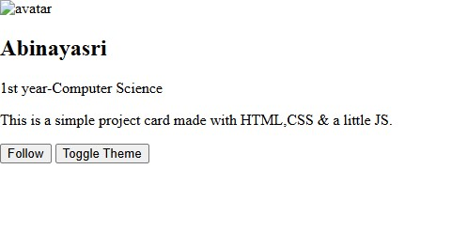
RESULTS AND SCREENSHOTS
The profile card is successfully created and tested in the browser.

Slide 11
conclusion
The project successfully demonstrates how HTML, CSS and JavaScript can be combined to create an attractive and functional web component.

